Slide 1
Statistical Signal Processing
2020 – 2021
Year IV, Telecommunication Technologies and Systems
Faculty of Electronics, Telecommunications and Information Technology

Slide 2
General Information (I)
Course organizer and teaching assistant
Course: Prof. Daniela Tărniceriu
Applications: Asoc. Prof. Nicolae Cleju

Slide 3
General Information(II)
􀂄 website
http://telecom.etc.tuiasi.ro/pns/
􀂄 Bibliografy
Tarniceriu, D., Bazele prelucrarii numerice a semnalelor, Ed. Politechnium, Iaşi, 2008, 372 pagini, ISBN 978-973-621-196-6.
Tărniceriu, D., Filtrare digitală, Ed. Tehnopres, Iasi 2004, ISBN 973 – 702 – 044 – 8, 2004, 331 pagini.
Munteanu, V., Tarniceriu D., Teoria estimarii si filtrare optimala, Ed. Tehnopres, 2006.
Ciochină, S., Prelucrarea numerică a semnalelor - partea I, U. P. B., 1995.
Grigoraş, V., Tărniceriu, D., Prelucrarea numerică a semnalelor, Ed. Gh. Asachi Iaşi, 1995.
Jackson, L. B., Digital Filters and Signal Processing, Kluwer Academic Publisher, Hingham, 1989.
Munteanu, V., Teoria Transmisiunii Informaţiei, Ed. Gh. Asachi Iaşi, 2002.
V. Oppenheim, R. W. Shafer, Discrete - Time Signal Processing, Englewood Cliffs, NJ. Prentice Hall, 1989.
Papoulis, A., Probability, Random Variables and Stochastic Processes, McGraw-Hill, New York, 1984.
Proakis, J. G., Manolakis, D. G., Introduction to Digital Signal Processing, New York Macmillian, 1992.
Tărniceriu, D., Grigoraş, V., Prelucrarea numerică a semnalelor, Ed. Gh. Asachi Iaşi, 1995.
Mitra, S. K., Digital signal Processing, McGraw Hill, 2002.

Slide 4
Discipline structure
Statistical Signal Processing optional
Semester | Number of hours per week |  |  |  | Assesment | Total number of hours |  |  |  | Total number of hours discipline
 | C | S | L | P |  | C | S | L | P
8 | 3 |  | 2 |  | E | 42 |  | 28 |  | 70
Prerequisite
Mathematics - probabilities, statistics,
Digital Signal Processing
Decision and Estimation in Data Processing – random signals
Assessment
Final evaluation: Written questionnaire 60%,
Practical demonstration 20%, Continuous tests 20%

Slide 5
Course structure
Direct design techniques for digital IIR filters
Structures for the realization of discrete-time systems
Quantization effects in digital signal processing
Linear prediction and optimal filtering
Power spectrum estimation

Slide 6
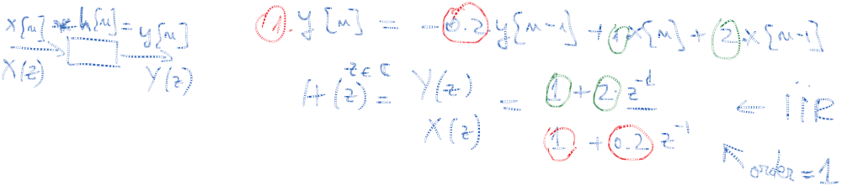
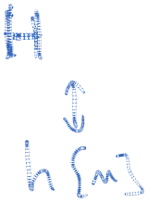



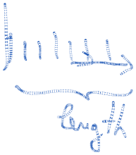

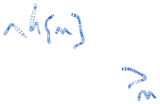




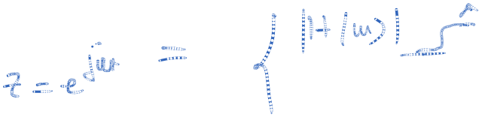
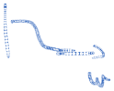







Recap
Digital signal processing basics:
  system, system function
  impulse response: what it is
  FIR / IIR systems: what they are, how they differ
  order of a filter
  transfer function: complex numbers, modulus and phase, interpretation of modulus and phase
  poles, zeros: what they are, interpretation
  basic filter types: lowpass, highpass, bandpass
  non-ideal filters: transition band, passband ripple, stopband ripple

Slide 7
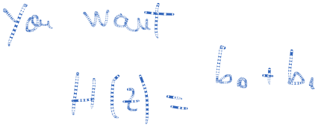
Direct design techniques for digital IIR filters
These design methods are based on numerical optimization

Slide 8
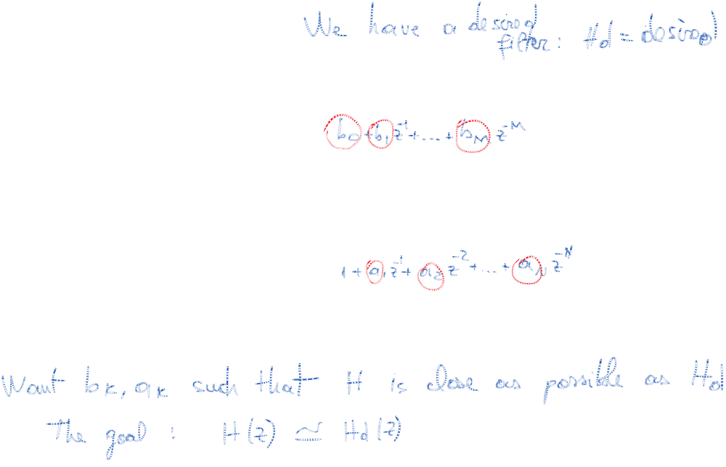
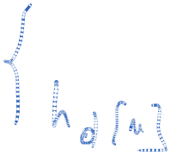
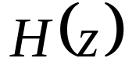

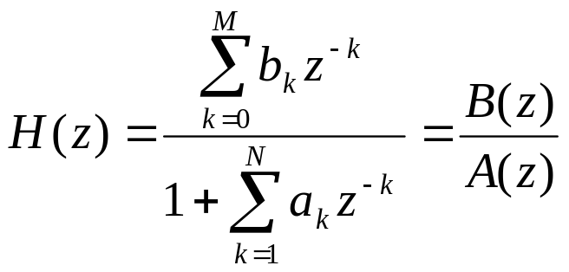


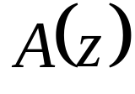
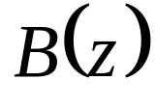

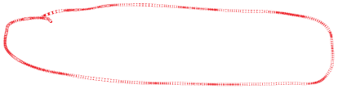

The direct design of IIR filters implies the following steps:
Consider a rational system function
The orders M and N of polynomials and are fixed;
(1)

Slide 9
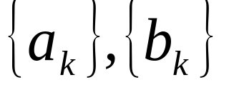
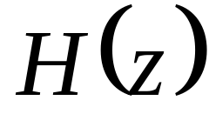
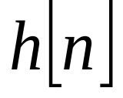

The direct design of IIR filters implies the following steps:
Choose a criterion to minimize the error;
Use an iterative algorithm to get coefficients
of or so that the error between the desired response and the actual response is minimized.

Slide 10
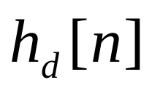


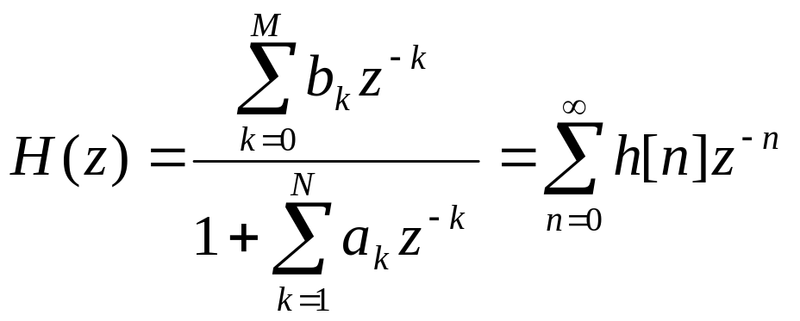


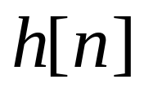


Padé approximation method
The desired impulse response is specified for
The system function of the filter to be designed is
is its unit sample response
parameters
(2)

Slide 11
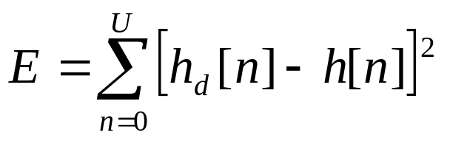

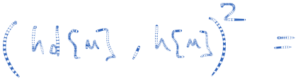
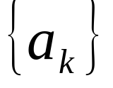
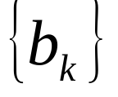
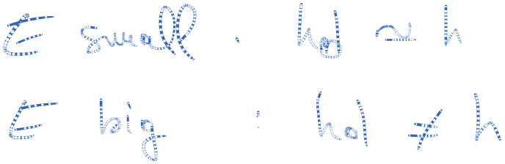
Padé approximation method
The least-squares error criterion is often used in optimization problems. We minimize the sum of the squared errors
with respect to the filter parameters and
U is some preselected upper limit in the summation
(3)

Slide 12
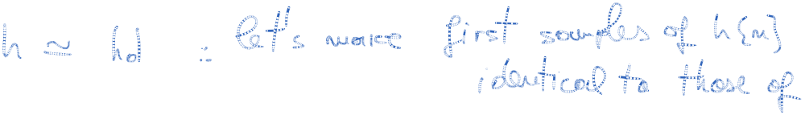



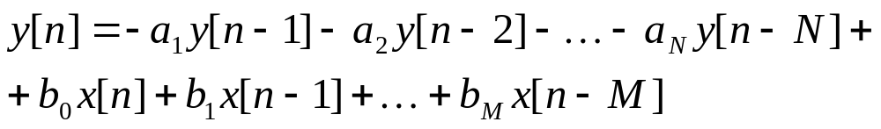
Padé approximation method
If it is possible to match h[n] perfectly to the desired response for
The filter to be designed is described by the difference equation
(4)

Slide 13
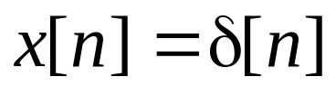
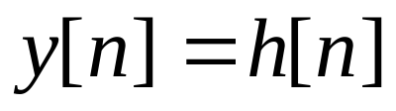
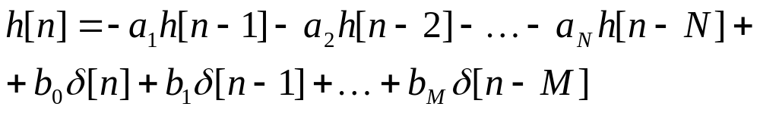


Padé approximation method
The input to the filter is a unit sample
The output is
(5)
but
(6)

Slide 14

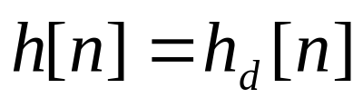
Padé approximation method
For , relation (5) becomes
We set for and we use (7) to solve for the filter parameters
We use values for the in (6) to solve for the filter parameters
(7)

Slide 15
Padé approximation method
The degree in which this design technique produces acceptable filters depends in part on the number of filter coefficients selected.
This is also a major limitation, resulting in a large number of poles and zeros.

Slide 16
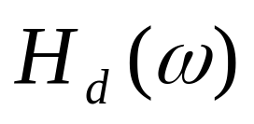
Padé approximation method
Padé approximation results in a perfect match to H_{d}(z), when the desired system function is rational and we have prior knowledge of the number of poles and zeros in the system. This is not the case in practice, since h_{d}[n] is determined from some desired frequency specifications

Slide 17
Padé approximation method
An effective approach in using the Padé approximation is to try different values of M and N until the frequency responses of the resulting filters converge to the desired frequency response within some small, acceptable approximation error.

Slide 18

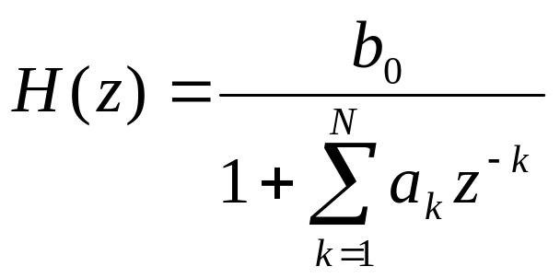
Least-squares design methods
We adopt a model for the system and determine its parameters to minimize the error between the desired system and the actual system with respect to the least squares.
Assume that is specified for
The digital filter to be designed contains only poles
(8)

Slide 19
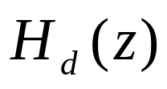
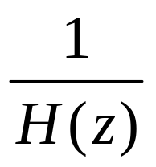
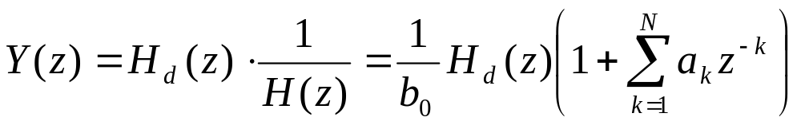
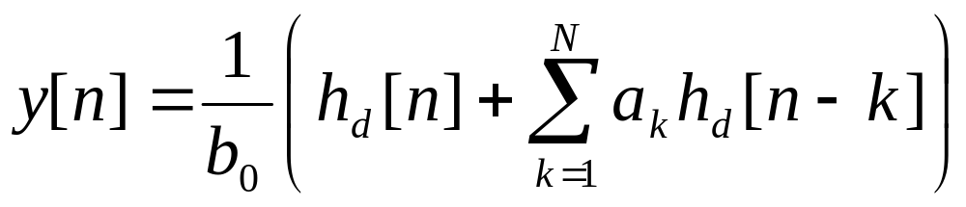
Least-squares design methods
Consider the cascade connection of the desired filter with the reciprocal all-zero filter
(9)
(10)

Slide 20
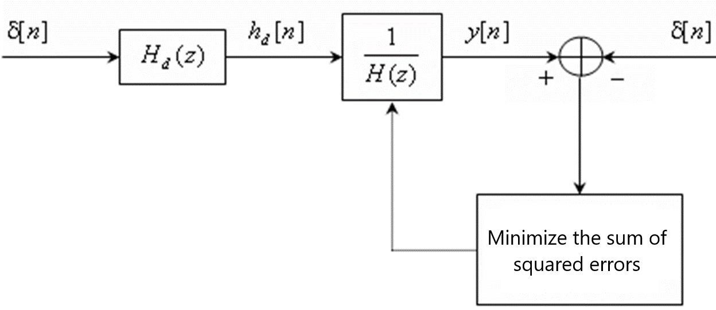
Least-squares design methods
Least-squares inverse filter design method

Slide 21
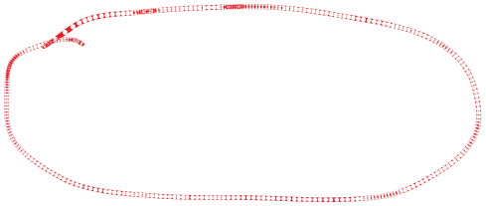
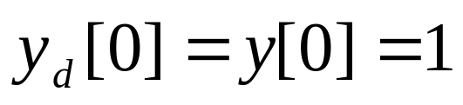
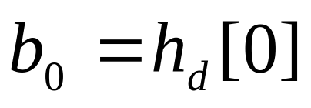


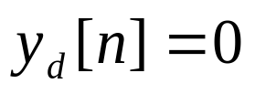
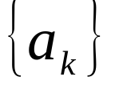
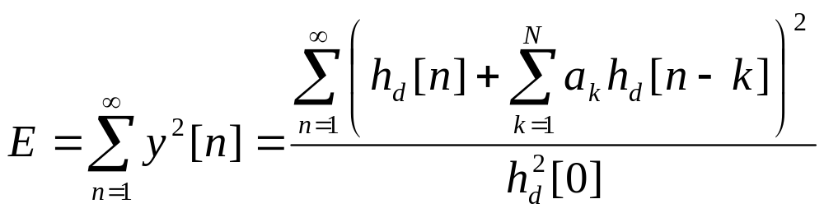
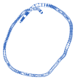

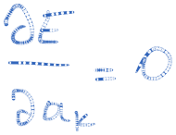
Least-squares design methods
For , represents the error between the desired output and the actual input.
Parameters are selected to minimize the sum of the error sequence:
(11)

Slide 22
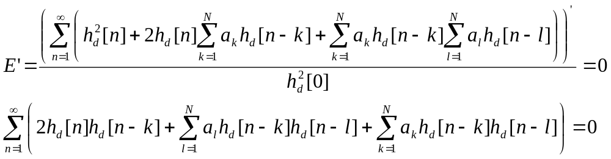
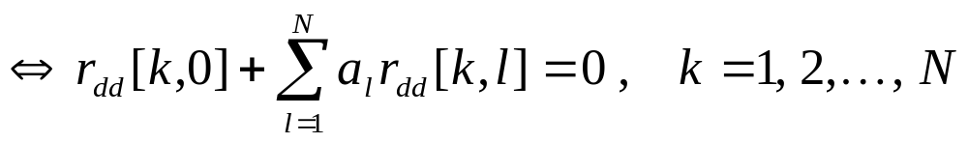
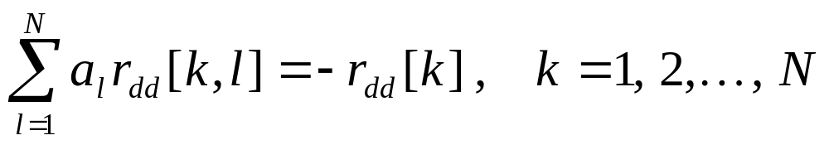
Least-squares design methods
(12)

Slide 23
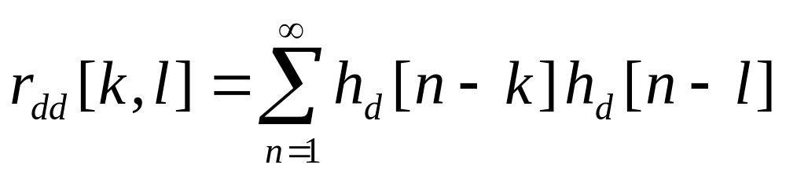



Least-squares design methods
(13)
(14)
(15)
(16)

Slide 24






Least-squares design methods
This method is called Least-squares inverse filter design method
Practically, the desired impulse response is specified for a finite set of points
The correlation sequence can be computed from the finite sequence
(17)
(18)
(19)
(20)

Slide 25





Prony’s Method
The least-squared method can also be used in a pole-zero approximation for . If the filter that approximates has both poles and zeros, its response to the unit impulse is
(28)
(29)

Slide 26





Prony’s Method
(30)
We can use the desired response for to construct an estimate of , according to (30)
We select parameters {a_{k}} to minimize the sum of squared errors between the desired response and the estimate.
(31)
(32)

Slide 27






Prony’s Method
The minimization of with respect to pole parameters
leads to the set of linear equations
Parameters {b_{k}} that determines the zeros can be obtained from (29), where h[n]=h_{d}[n].
(33)
(34)
(35)

Slide 28



Prony’s Method
Parameters that determine the poles are obtained by the method of least squares;
Parameters that determine the zeros are obtained by the Padé approximation method.

Slide 29




Shanks’ Method
The both sets of parameters and are determined by application of the least-squares method proposed by Shanks.
The parameters are computed according to (33), as indicated above. This yields the estimate which allows us to synthesize the all-pole filter
with the impulse response
(36)
(37)

Slide 30










Shanks’ Method
Least squares method for determining the poles and zeros of a filter
(38)
(39)

Slide 31











Shanks’ Method
(40)
We obtain a set of linear equations for parameters
(41)
(42)
(43)
(44)

Slide 32



FIR Least-Squares Inverse (Wiener) Filters
The inverse to a LTIS is
In practical applications it is desirable to restrict the inverse filter to be FIR.
One simple method is to truncate h_{i}[n] to M+1 samples.
Doing so, the total squared approximation error is
(45)
(46)
(47)

Slide 33

FIR Least-Squares Inverse (Wiener) Filters
d[n] denotes the desired output sequence of the FIR filter of length M+1
h[n] denotes the input sequence.
The error sequence between the desired output and the actual output is
b_{k} are the FIR filter coefficients
(48)

Slide 34














FIR Least-Squares Inverse (Wiener) Filters
Least squares FIR inverse filter
The sum of squares of the error sequence is
(49)

Slide 35









FIR Least-Squares Inverse (Wiener) Filters
Minimizing E with respect to the filter coefficients, we obtain the set of linear equations
r_{hh}[l] is the autocorrelation of h[n], (assumed stationary) defined as
(50)
(51)

Slide 36






FIR Least-Squares Inverse (Wiener) Filters
r_{dh}[l] is the crosscorrelation between the desired output d[n], and the input signal h[n] defined as
Wiener filter– the optimum in the least-square sense
For d[n]=δ[n]
(52)
r_{dh}[l] =
(53)

Slide 37











FIR Least-Squares Inverse (Wiener) Filters
(54)
(55)
(56)
(57)

